Slide 1
Network Infrastructure Security
Information Security

Slide 2
Network Infrastructure Security
Securing a Network
Security through Network Design
  Subnetting
  Virtual LAN (VLAN)
  Demilitarized Zone (DMZ)
  Security through Network Technologies
  Network Address Translation (NAT)
  Virtual Private Networks (VPN)

Slide 3
Network Infrastructure Security
Applying Network Security Devices
  Firewalls
  Proxy Servers
  Honeypots
  Network Intrusion Detection Systems
  Host and Network Intrusion Prevention Systems
  Network Protocol Analyzers

Slide 4
Network Infrastructure Security
Security through Network Technologies: NAT
Network Address Translation (NAT)
  Hides the IP addresses of network devices from attackers
Private addresses
  IP addresses not assigned to any specific user or organization
  Function as regular IP addresses on an internal network
  Non-routable addresses

Slide 5
Network Infrastructure Security
Security through Network Technologies: NAT
NAT removes the private IP address from the sender’s packet
  And replaces it with a public IP address
When a packet is returned to NAT, the process is reversed
An attacker who captures the packet on the Internet cannot determine the actual IP address of the sender

Slide 6
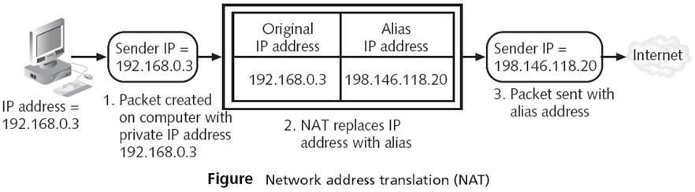
Network Infrastructure Security
Security through Network Technologies: NAT

Slide 7
Network Infrastructure Security
Security through Network Technologies: NAT
Private Network
Internet
Source
Source
= 10.0.1.2
Source
= 128.143.71.21
= 10.0.1.2
Source
= 128.143.71.21
= 64.236.24.4
Destination
= 64.236.24.4
Destination
Destination
= 64.236.24.4
Destination
= 64.236.24.4
private address: 10.0.1.2
NAT
Device
public address: 128.143.71.21
Host
Source
= 64.236.24.4
Source
= 64.236.24.4
Public Host
= 64.236.24.4
= 64.236.24.4
= 64.236.24.4
Source
= 64.236.24.4
Source
Source
Destination
= 10.0.0.2
Source
Destination
= 128.59.16.21
Destination
64.236.24.4
Destination
Destination
Destination
= 128.59.16.21
= 128.59.16.21
= 128.59.16.21
= 10.0.0.2
Private
Public
Address
Address
10.0.1.1
128.59.16.21

Slide 8
Network Infrastructure Security
Security through Network Technologies: VPN
Virtual Private Networks (VPNs)
  A Virtual Private Network (VPN) can be viewed as a private network which is connected through a public network.
  Virtual Private Networks (VPNs) are used to connect LANs together across the Internet.
  Using Virtual Private Network (VPN) technologies, remote users can connect to enterprise network securely over the public internet
  This encrypted connection helps ensure that sensitive data is safely transmitted.
  It prevents unauthorized people from eavesdropping on the traffic and allows the user to conduct work remotely.

Slide 9
Network Infrastructure Security
Security through Network Technologies: VPN
Virtual Private Networks (VPNs)
  Virtual Private Network (VPN) connections use either Point-to-Point Tunneling Protocol (PPTP) or Layer Two Tunneling Protocol/Internet Protocol security (L2TP/IPSec) over internet.
  PPTP was created by Microsoft and available since Windows NT 4.0 Routing and Remote Access Services.
  Point-to-Point Tunneling Protocol (PPTP) encrypts the data it encapsulates, but the header is not encrypted.

Slide 10
Network Infrastructure Security
Security through Network Technologies: VPN
Virtual Private Networks (VPNs)
  IPSec encrypts the entire L2TP packet. A advantage of L2TP over PPTP is that eavesdroppers cannot identify that a VPN is in use, because IPSec encrypts the L2TP header information also.
  Hence, L2TP/IPSec protocol is much more secure than Point-to-Point Tunneling Protocol (PPTP).

Slide 11
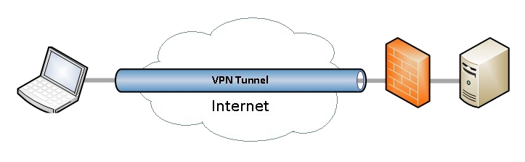
Network Infrastructure Security
Security through Network Technologies: VPN

Slide 12
Network Infrastructure Security
Applying Network Security Devices: Firewall
  Typically used to filter packets
  Sometimes called a packet filter
  Designed to prevent malicious packets from entering the network
  A firewall can be software-based or hardware-based
Hardware firewalls usually are located outside the network security perimeter
  As the first line of defense
  Configuring Windows Firewall

Slide 13
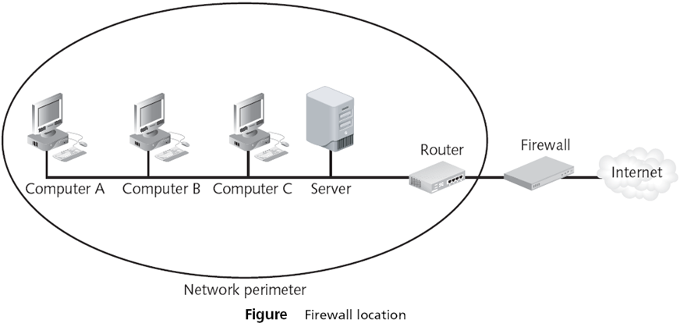
Network Infrastructure Security
Applying Network Security Devices: Firewall

Slide 14
Network Infrastructure Security
Applying Network Security Devices: Firewall
The basis of a firewall is a rule base
  Establishes what action the firewall should take when it receives a packet (allow, block, and prompt)
Stateless packet filtering
  Looks at the incoming packet and permits or denies it based strictly on the rule base
Stateful packet filtering
  Keeps a record of the state of a connection between an internal computer and an external server
  Then makes decisions based on the connection as well as the rule base
Notes:
If you select this rule type, the wizard will also prompt you to select users and computers that are authorized to establish this type of connection.

Slide 15
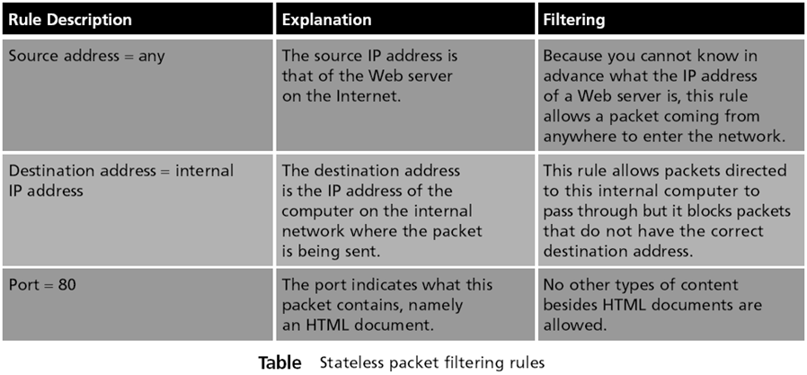
Network Infrastructure Security
Applying Network Security Devices: Firewall

Slide 16
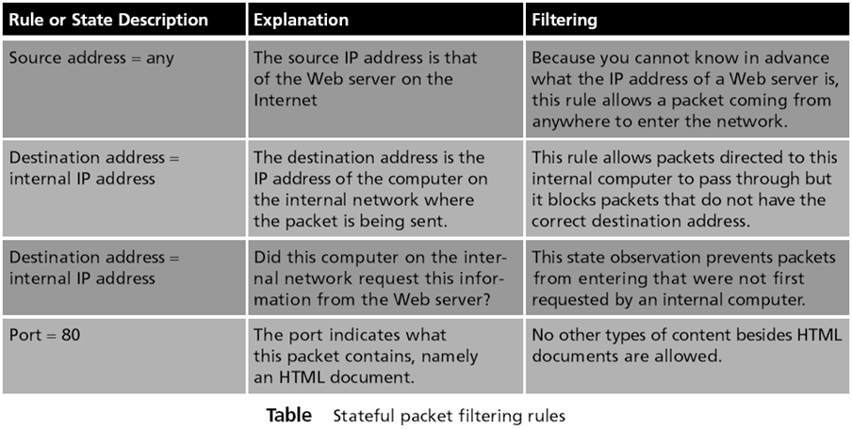
Network Infrastructure Security
Applying Network Security Devices: Firewall

Slide 17
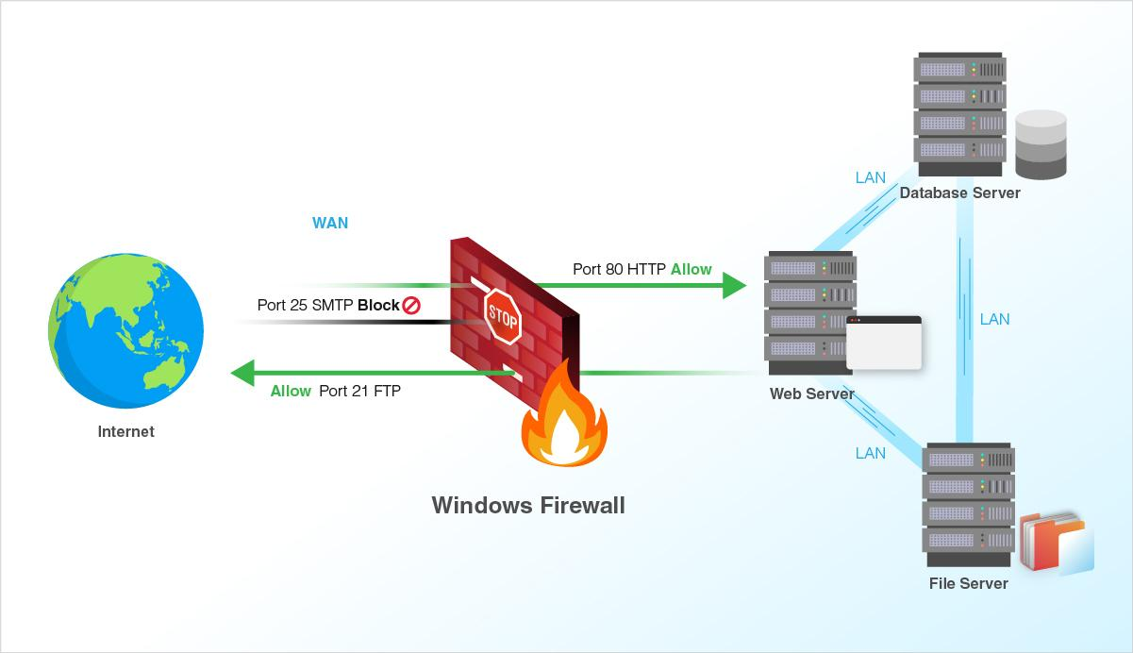
Network Infrastructure Security
Applying Network Security Devices: Firewall

Slide 18
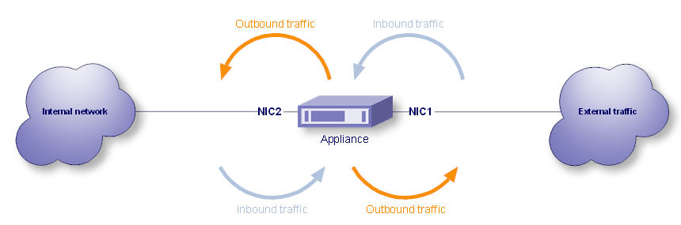
Network Infrastructure Security
Applying Network Security Devices: Firewall
Personal software firewalls have gradually improved their functionality
  Most personal software firewalls today also filter outbound traffic as well as inbound traffic
  Protects users by preventing malware from connecting to other computers and spreading

Slide 19
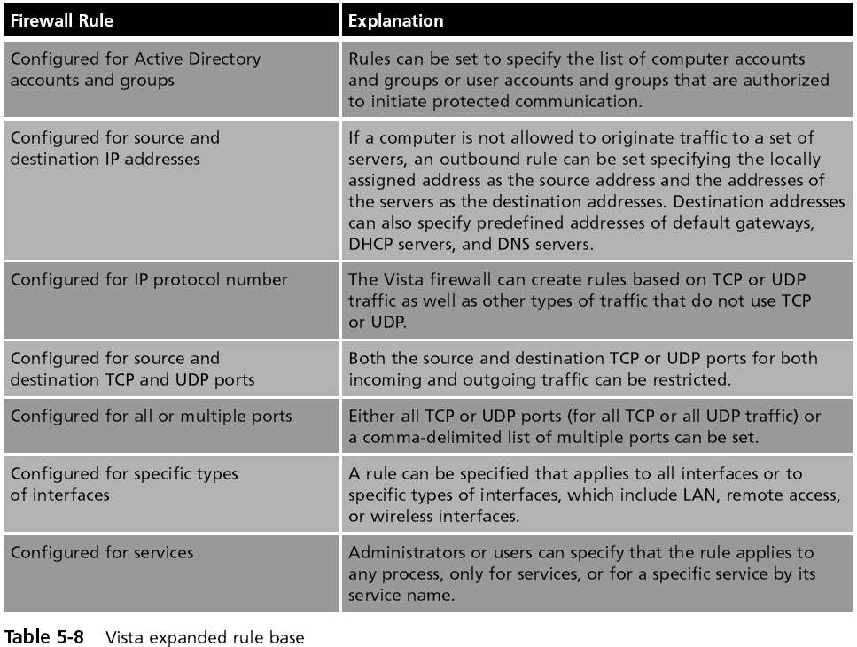
Network Infrastructure Security

Slide 20
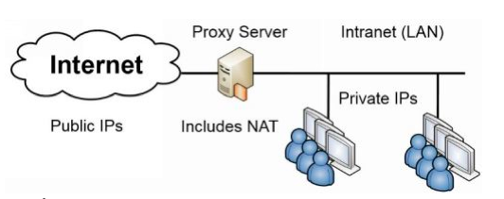
Network Infrastructure Security
Applying Network Security Devices: Proxy server
  A computer system (or an application program) that intercepts internal user requests and then processes that request on behalf of the user
  Clients cannot connect directly to the Internet, requests go to Proxy, which fetches the content (if it's permitted)
  Goal is to hide the IP address of client systems inside the secure network
  Reverse proxy: Does not serve clients but instead routes incoming requests to the correct server

Slide 21
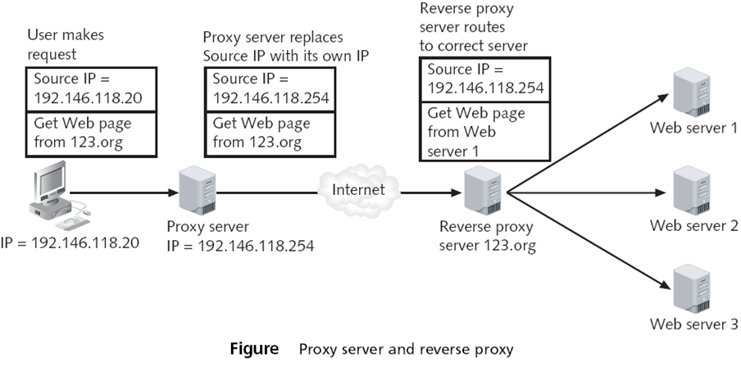
Network Infrastructure Security
Applying Network Security Devices: Proxy server

Slide 22
Network Infrastructure Security
Applying Network Security Devices: Proxy server
  Caching Proxy
  If many clients request the same page, such as yahoo.com
  The proxy only fetches one copy, and distributes it to all the clients
  Makes network seem faster

